Slide 1
Stirring/Heating Module Design Review #1
February 17th, 2026
Rudy Heredia-Jantz

Slide 2
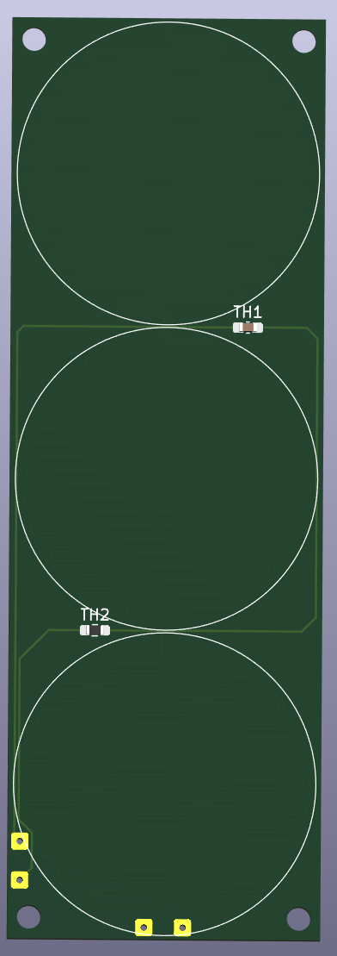
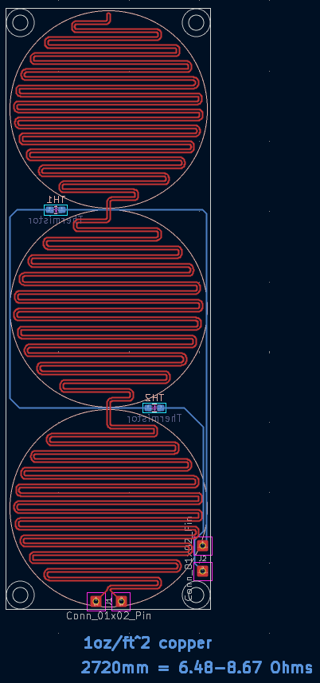
Updated Hot Plate
Adjusted heating element routing to follow shape of vial wells.
Added mounting holes for M2 standoffs.
Adjusted placement of wire contacts to minimize interference with magnet housing.
Two layer design allows for thermistors to read “true” surface temperature of the hot plate.

Slide 3
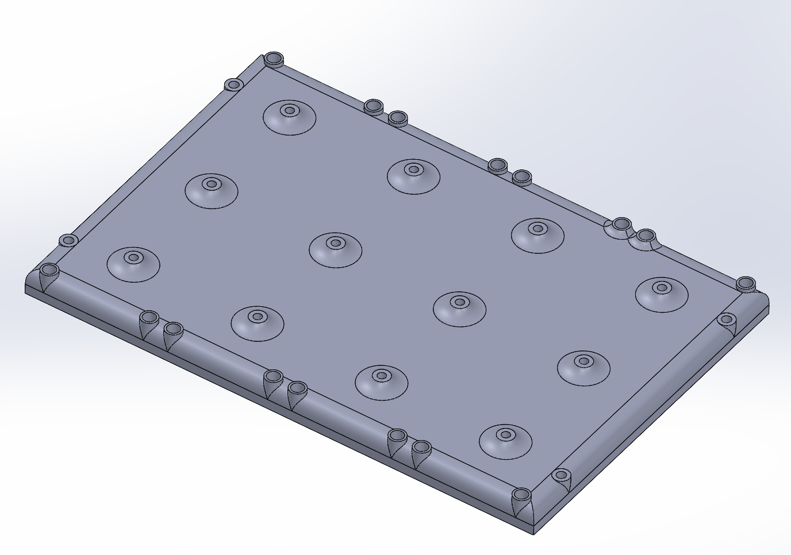
Motor Housing Cover
Protects motor housing internals in the event of a spill.
Beveled edges and shaft “necks” move liquids away from openings.
Standoffs are to be mounted using threaded inserts placed around the edge.
Mounts to main housing with M2 screws.

Slide 4
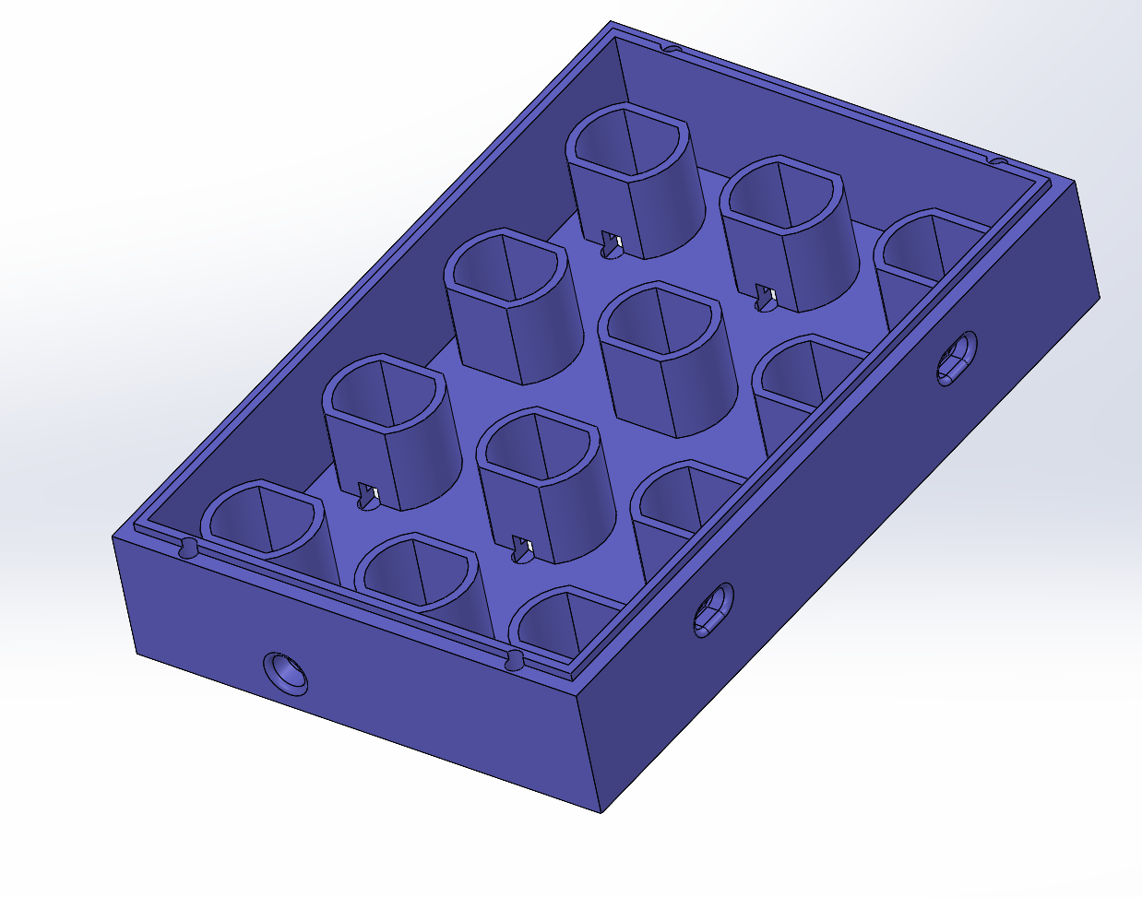
Updated Motor Housing
Added several access holes for inbound, outbound, and motor wiring.
Could be replaced with connectors.
Threaded inserts allow the lid to be secured to the main housing.
Lip ensures that the housing and lid are properly aligned.

Slide 5
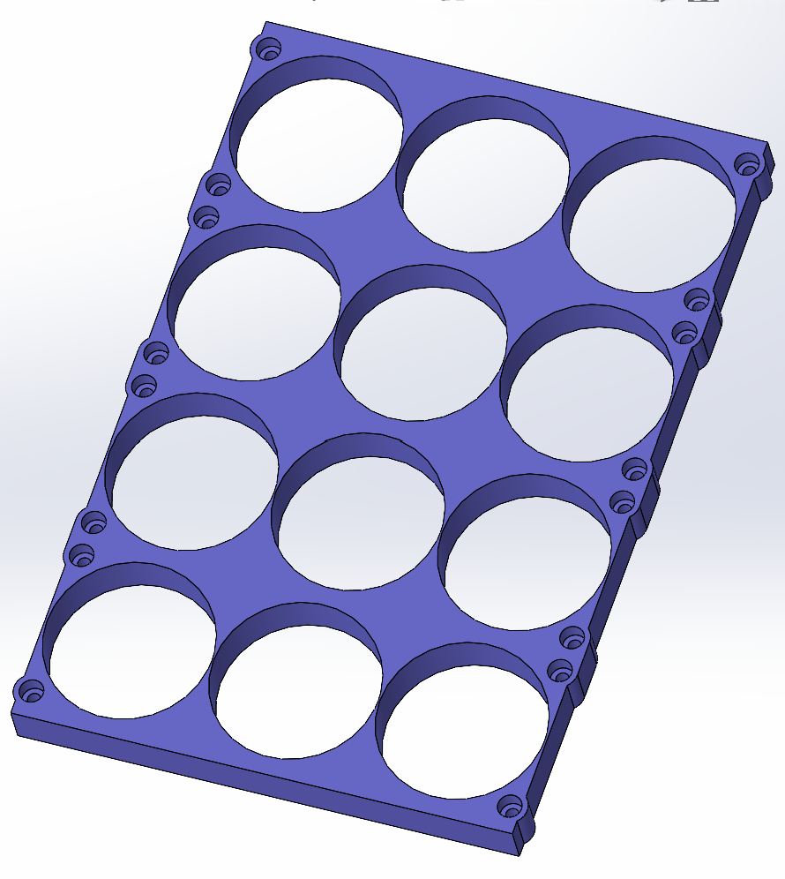
Updated Vial Wells
The vial well will be mounted to standoffs through countersunk screw holes.
Extra material was added to prevent cracking/deformation around the screws.
The extra material will not interfere with adjacent modules/wells.

Slide 6
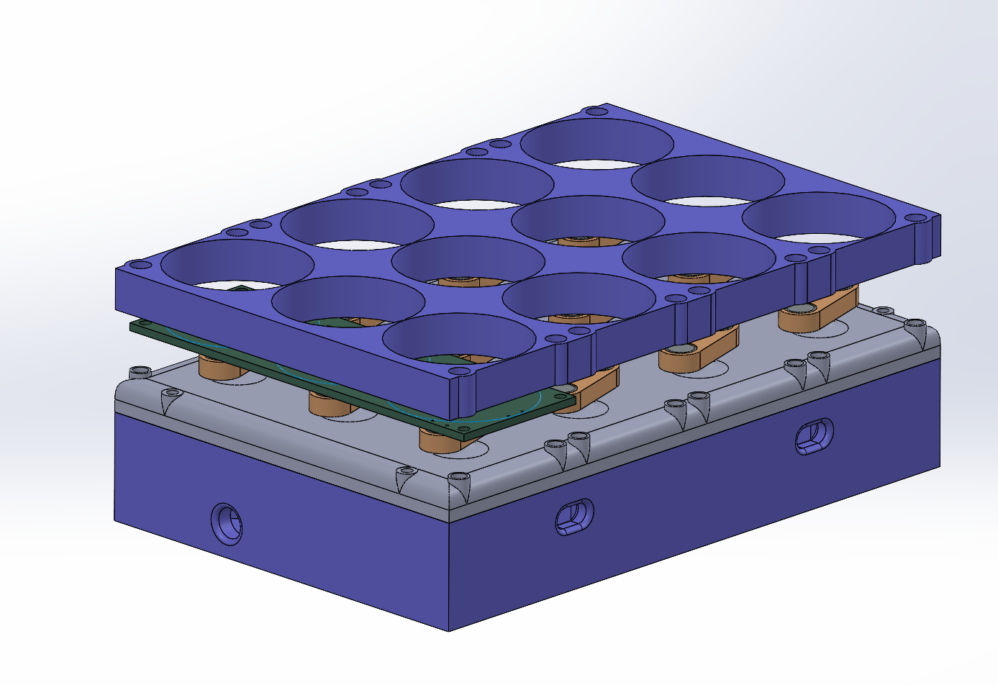
Updated Assembly
For the time being, this is what the final module with look like.
Slight modification will be made to account for changes in electrical design.
Standoffs must still be sourced and selected.
Polymer vs. metal standoffs, matter of electrical and thermal conductivity.
Benson Hall / ChemE prototyping capabilities?

Slide 7
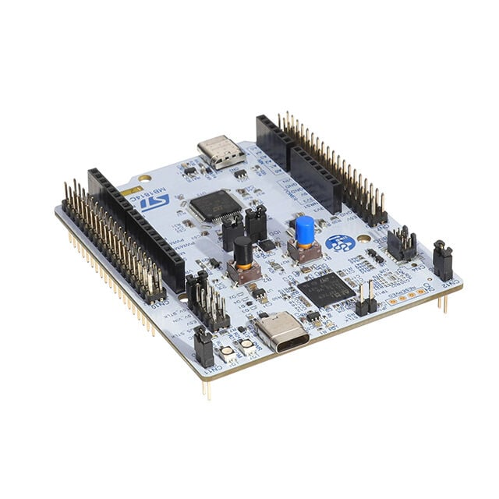
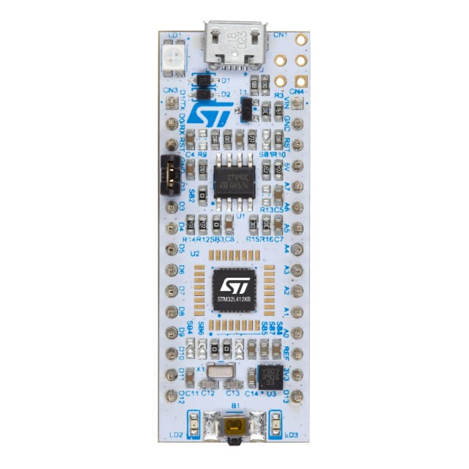
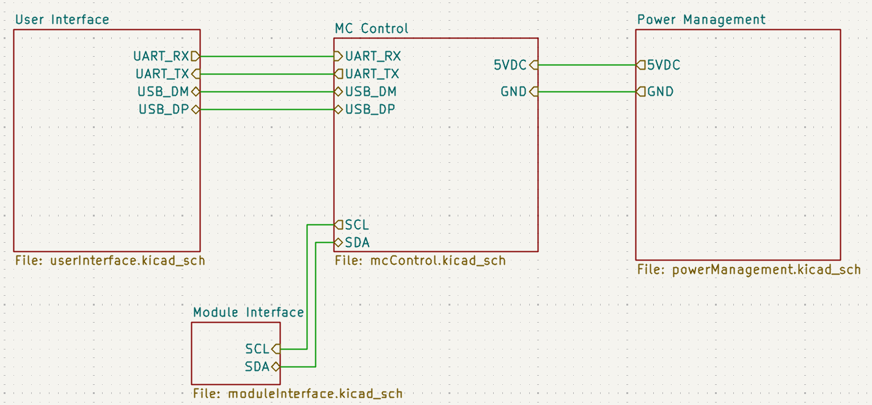
Modularity
After our last meeting I began looking into a modular/expandable system.
Central STM32H533RE MC, smaller STM32L412KB MC’s inside each module.
“Plug and play” can be implemented with I2C.
Would require custom housing / user interface.
Display, rotary encoder, selector buttons?
Standalone operation (Physical), Rasberry Pi integration (UART), computer interface (Serial-USB).
Future module support.

Slide 8
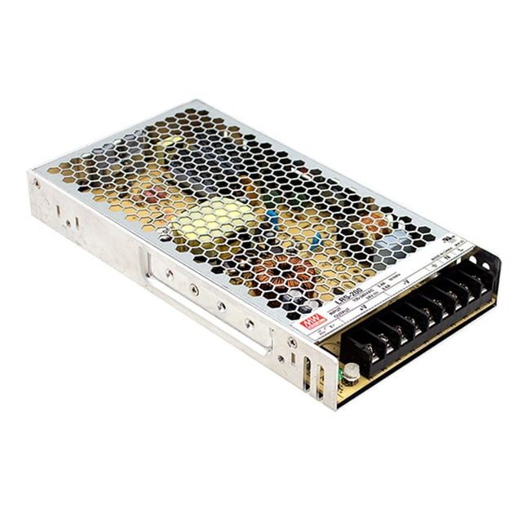
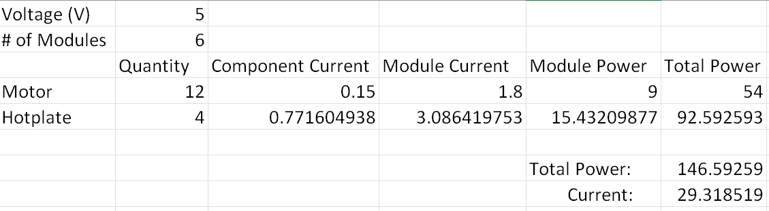
Power Concerns
~146W minimum power consumption.
29 A @ 5V.
6 H&S Module system.
Requires an external AC-DC power converter.
Safety measures must be put in place to ensure user and component wellbeing.
Fuses, emergency stop/contactor, pre/dis-charge circuits, ample grounding.
The hotplate currently consumes the most power.
Power consumption can be reduced, tradeoff is maximum temperature & rate of temperature change.

Slide 9
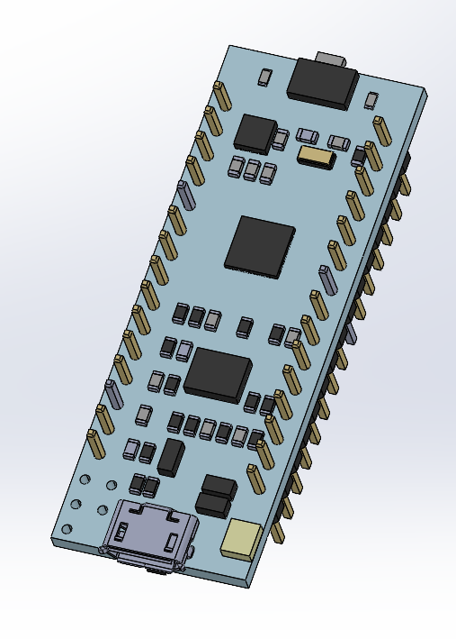
Next Steps
Internal module circuitry
High current PWM, MOSFET limitations.
Power management and distribution
Thermistor ADC’s
Control hub circuitry
User interface
Power distribution, safety measures
Control hub housing
Wiring
Wire gauge, current rating
Connectors

